Slide 1
Car service Introduction and Reservation
(CBNU) Open Source Web Software

Slide 2
Contents
1
Motive for development
2
Project idea and requirements
3
Roles of each team member
4
Schedule
Notes:
개발 동기
목표시장 분석
프로젝트 아이디어 및 요구사항
팀원의 역할
계발 일정

Slide 3
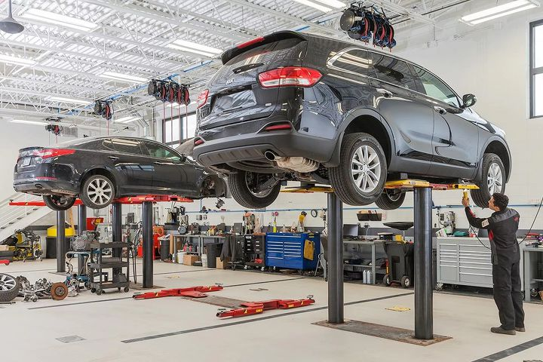
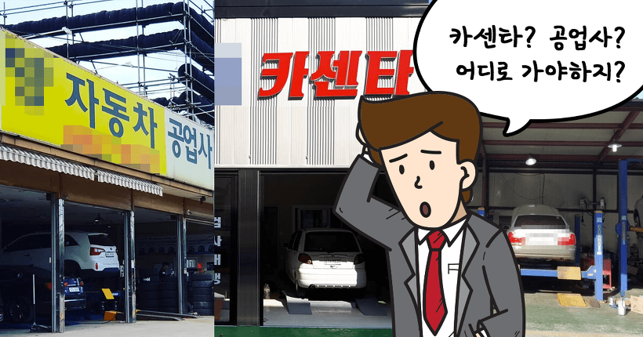
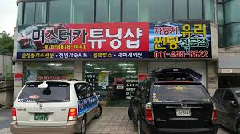
Motive for development
1
In order to receive
car-related services, you have to find information one by one and
wait for the service

Slide 4


Motive for development
1
How do we solve ?
We will make a website to introduce car-related services and make reservations.

Slide 5
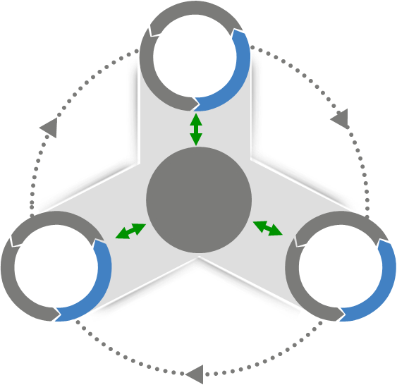

Project idea and requirements
2
The website integrates car-related services and allows you to search by store name or local name. In addition,
It has a reservation function.
The website includes communities using various bulletin boards.
Customers can use convenient services by sharing various reviews and information form actual users.
Car
Tuning#
Community
Customer
Car
Auto
Repair#
Car
Body#

Slide 6
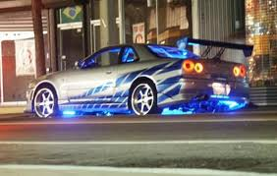
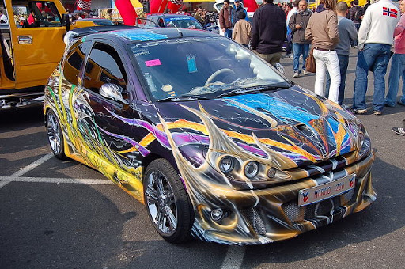
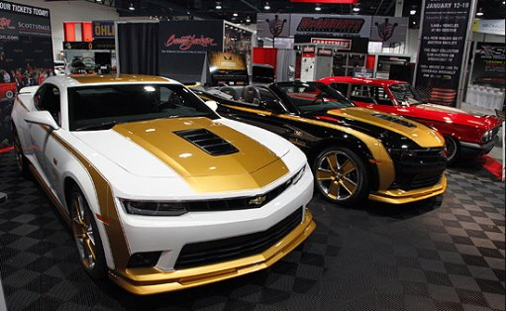
Project idea and requirements
2
It also provides the ability to virtually tune the vehicle (painting, sticker seals, parts, LEDs, exhaust sounds, tires, wheels, etc.)

Slide 7






Roles of each team member
3
Configure main screen and sub-page forms
Cho
Hyung
Jin
Tuning Simulator
Han
Jong
Hyuk
Yoon
Yong
Jin
Communities using bulletin boards
MapLinking and Searching, Reservation

Slide 8
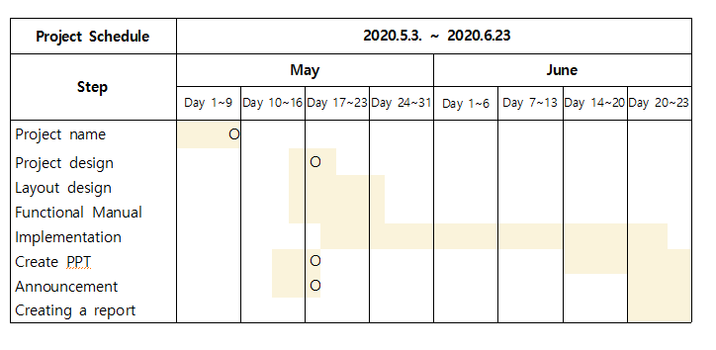

Schedule
4

Slide 9
Thank you !!

